Slide 1
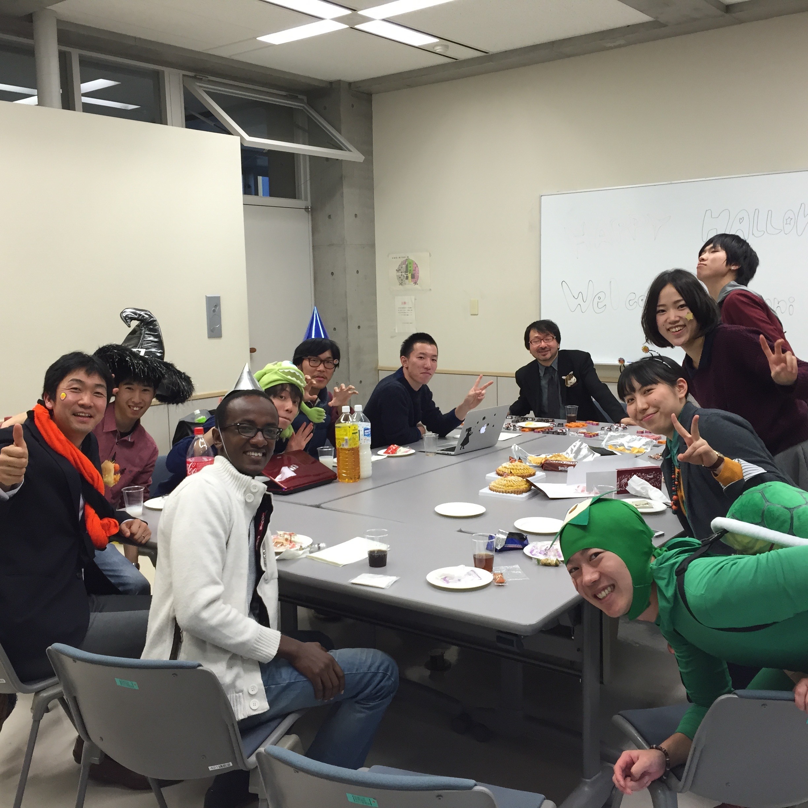
Story of Rwanda by Jovani
-Name: Jovani Ntabgoba
-Age: 29years
-Miyagi University Student MastersInformation Science
-From,Rwanda(East Africa)

Slide 2
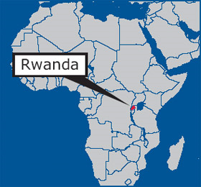
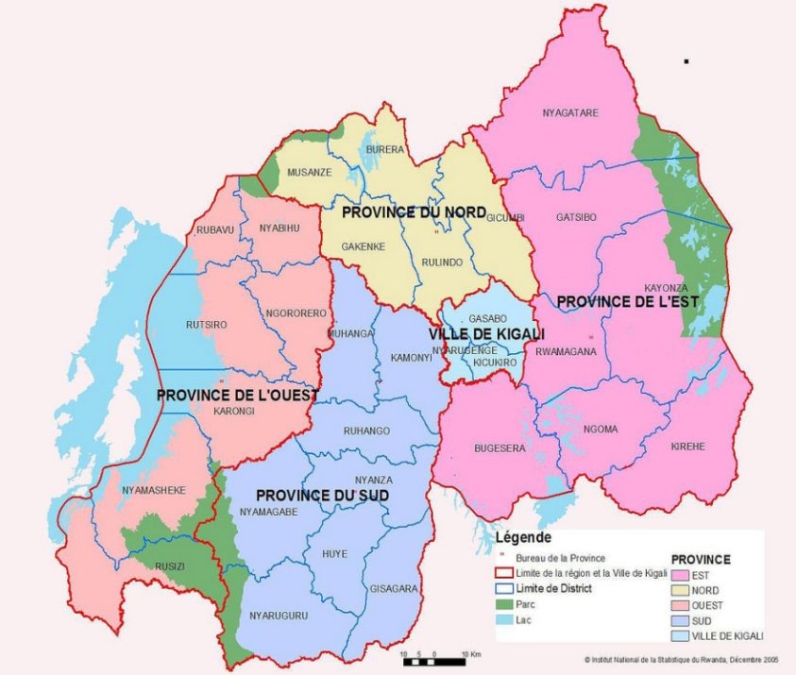
Location
Uganda
Tanzania
DRC
Population:12,000,000
Burundi

Slide 3
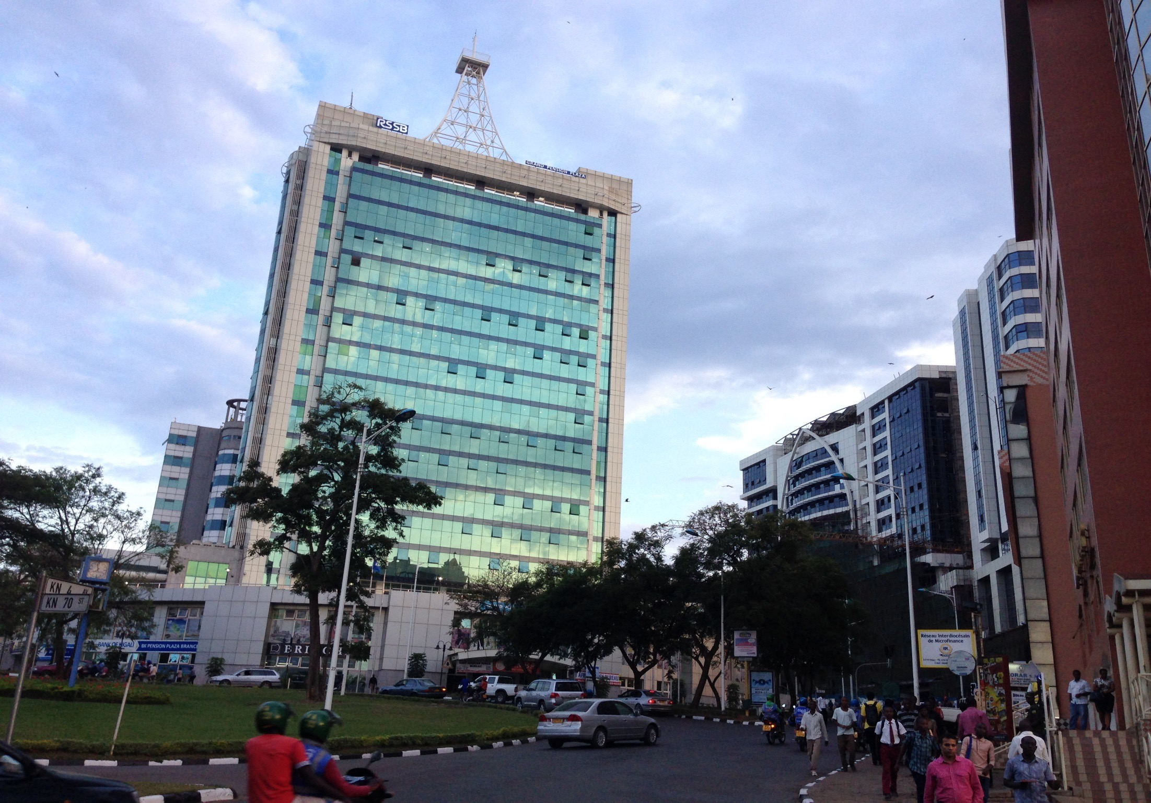
Kigali,-Rwanda Capital City

Slide 4
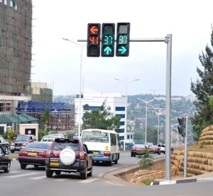
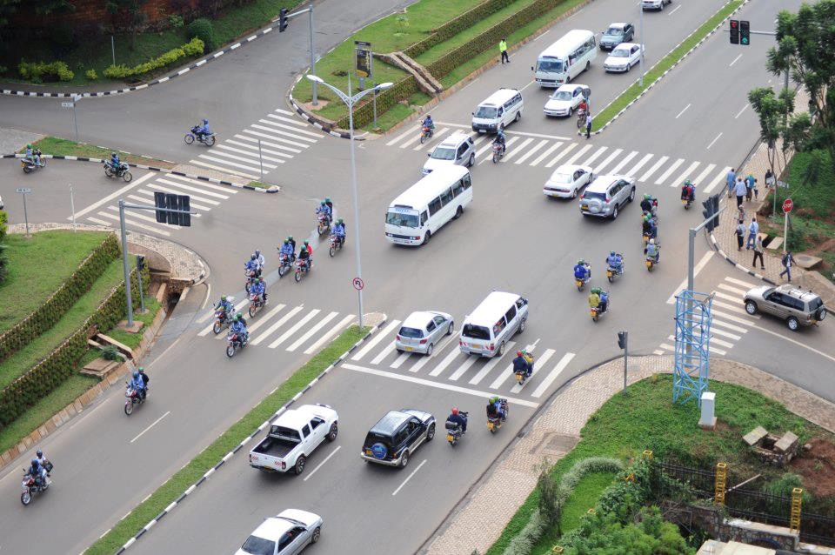
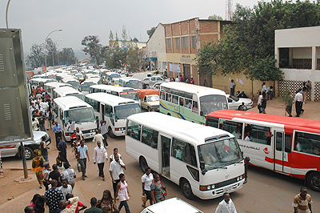
Rwanda -Transport

Slide 5
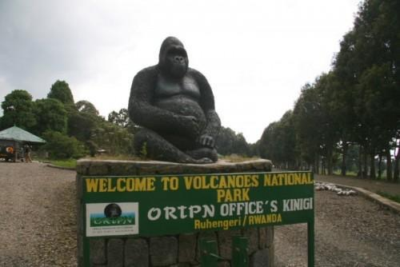
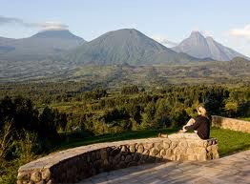
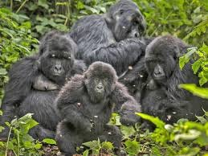
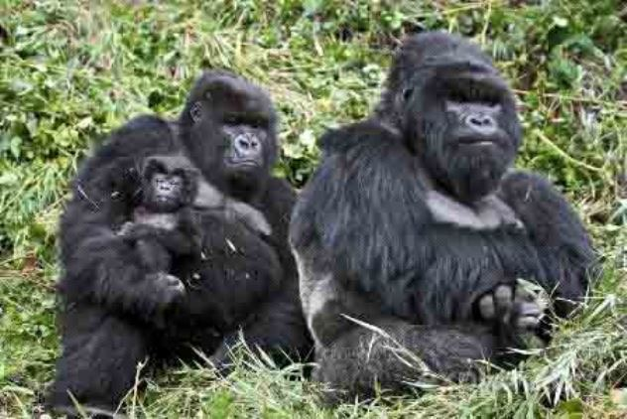
What Rwanda is known of?
Volcano National Park
Gorillas live in Families

Slide 6
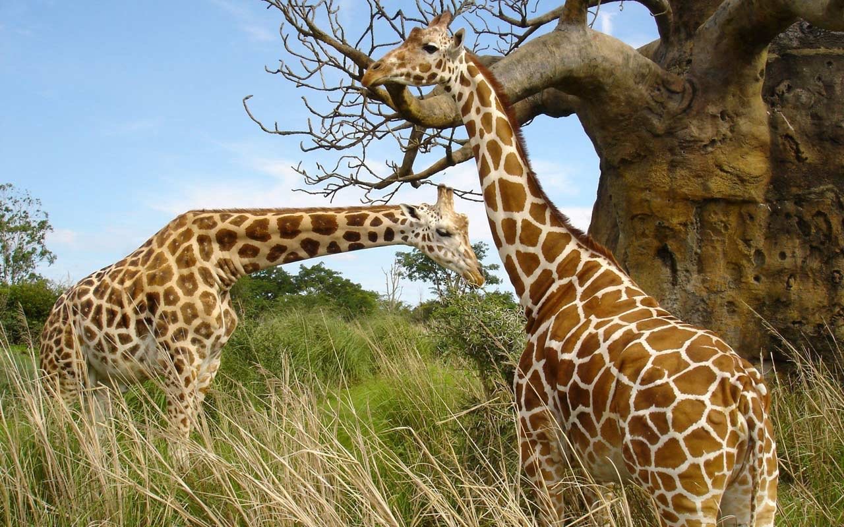
Zebra

Slide 7
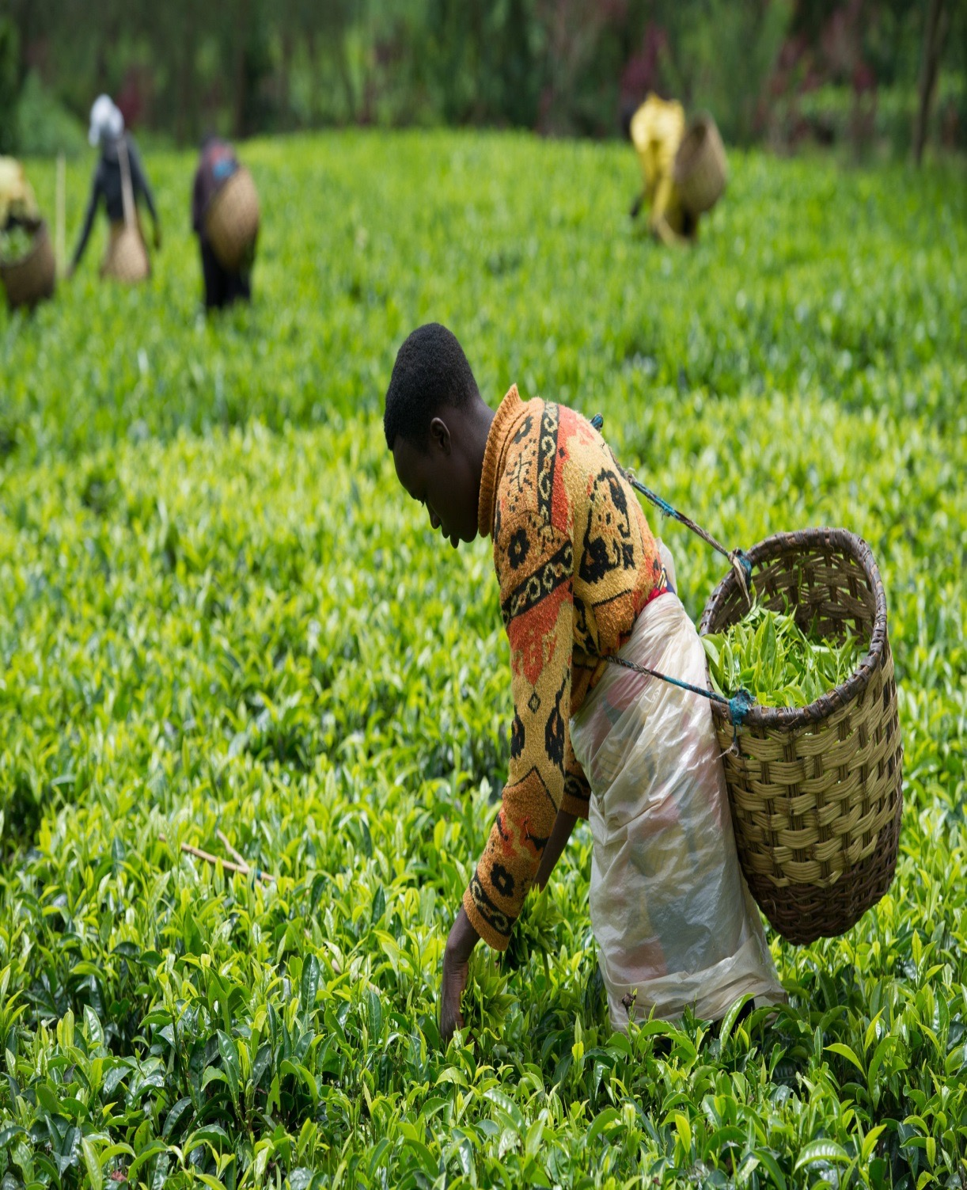
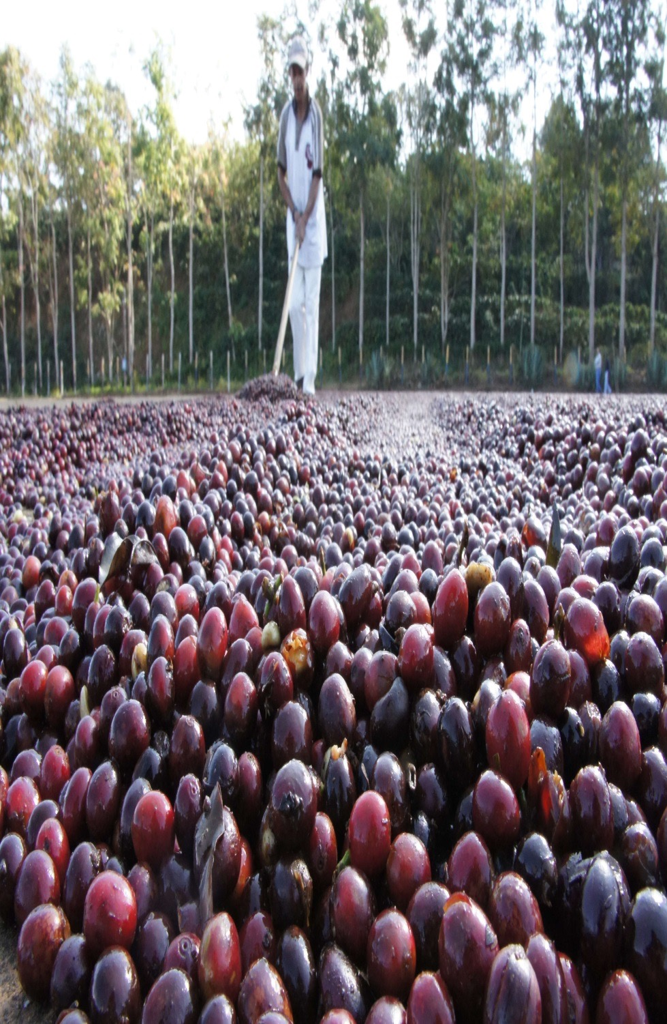
お茶の輸出
コーヒーの輸出

Slide 8
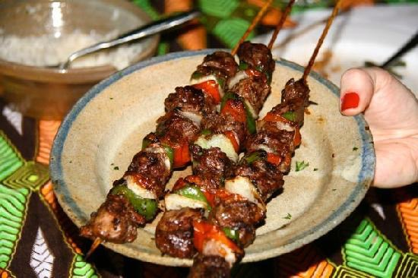
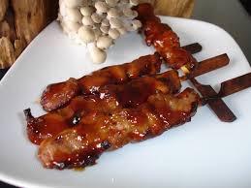
Rwanda’s Yakitori
Rwandan- with RedPaper
Japanese- Sweet

Slide 9
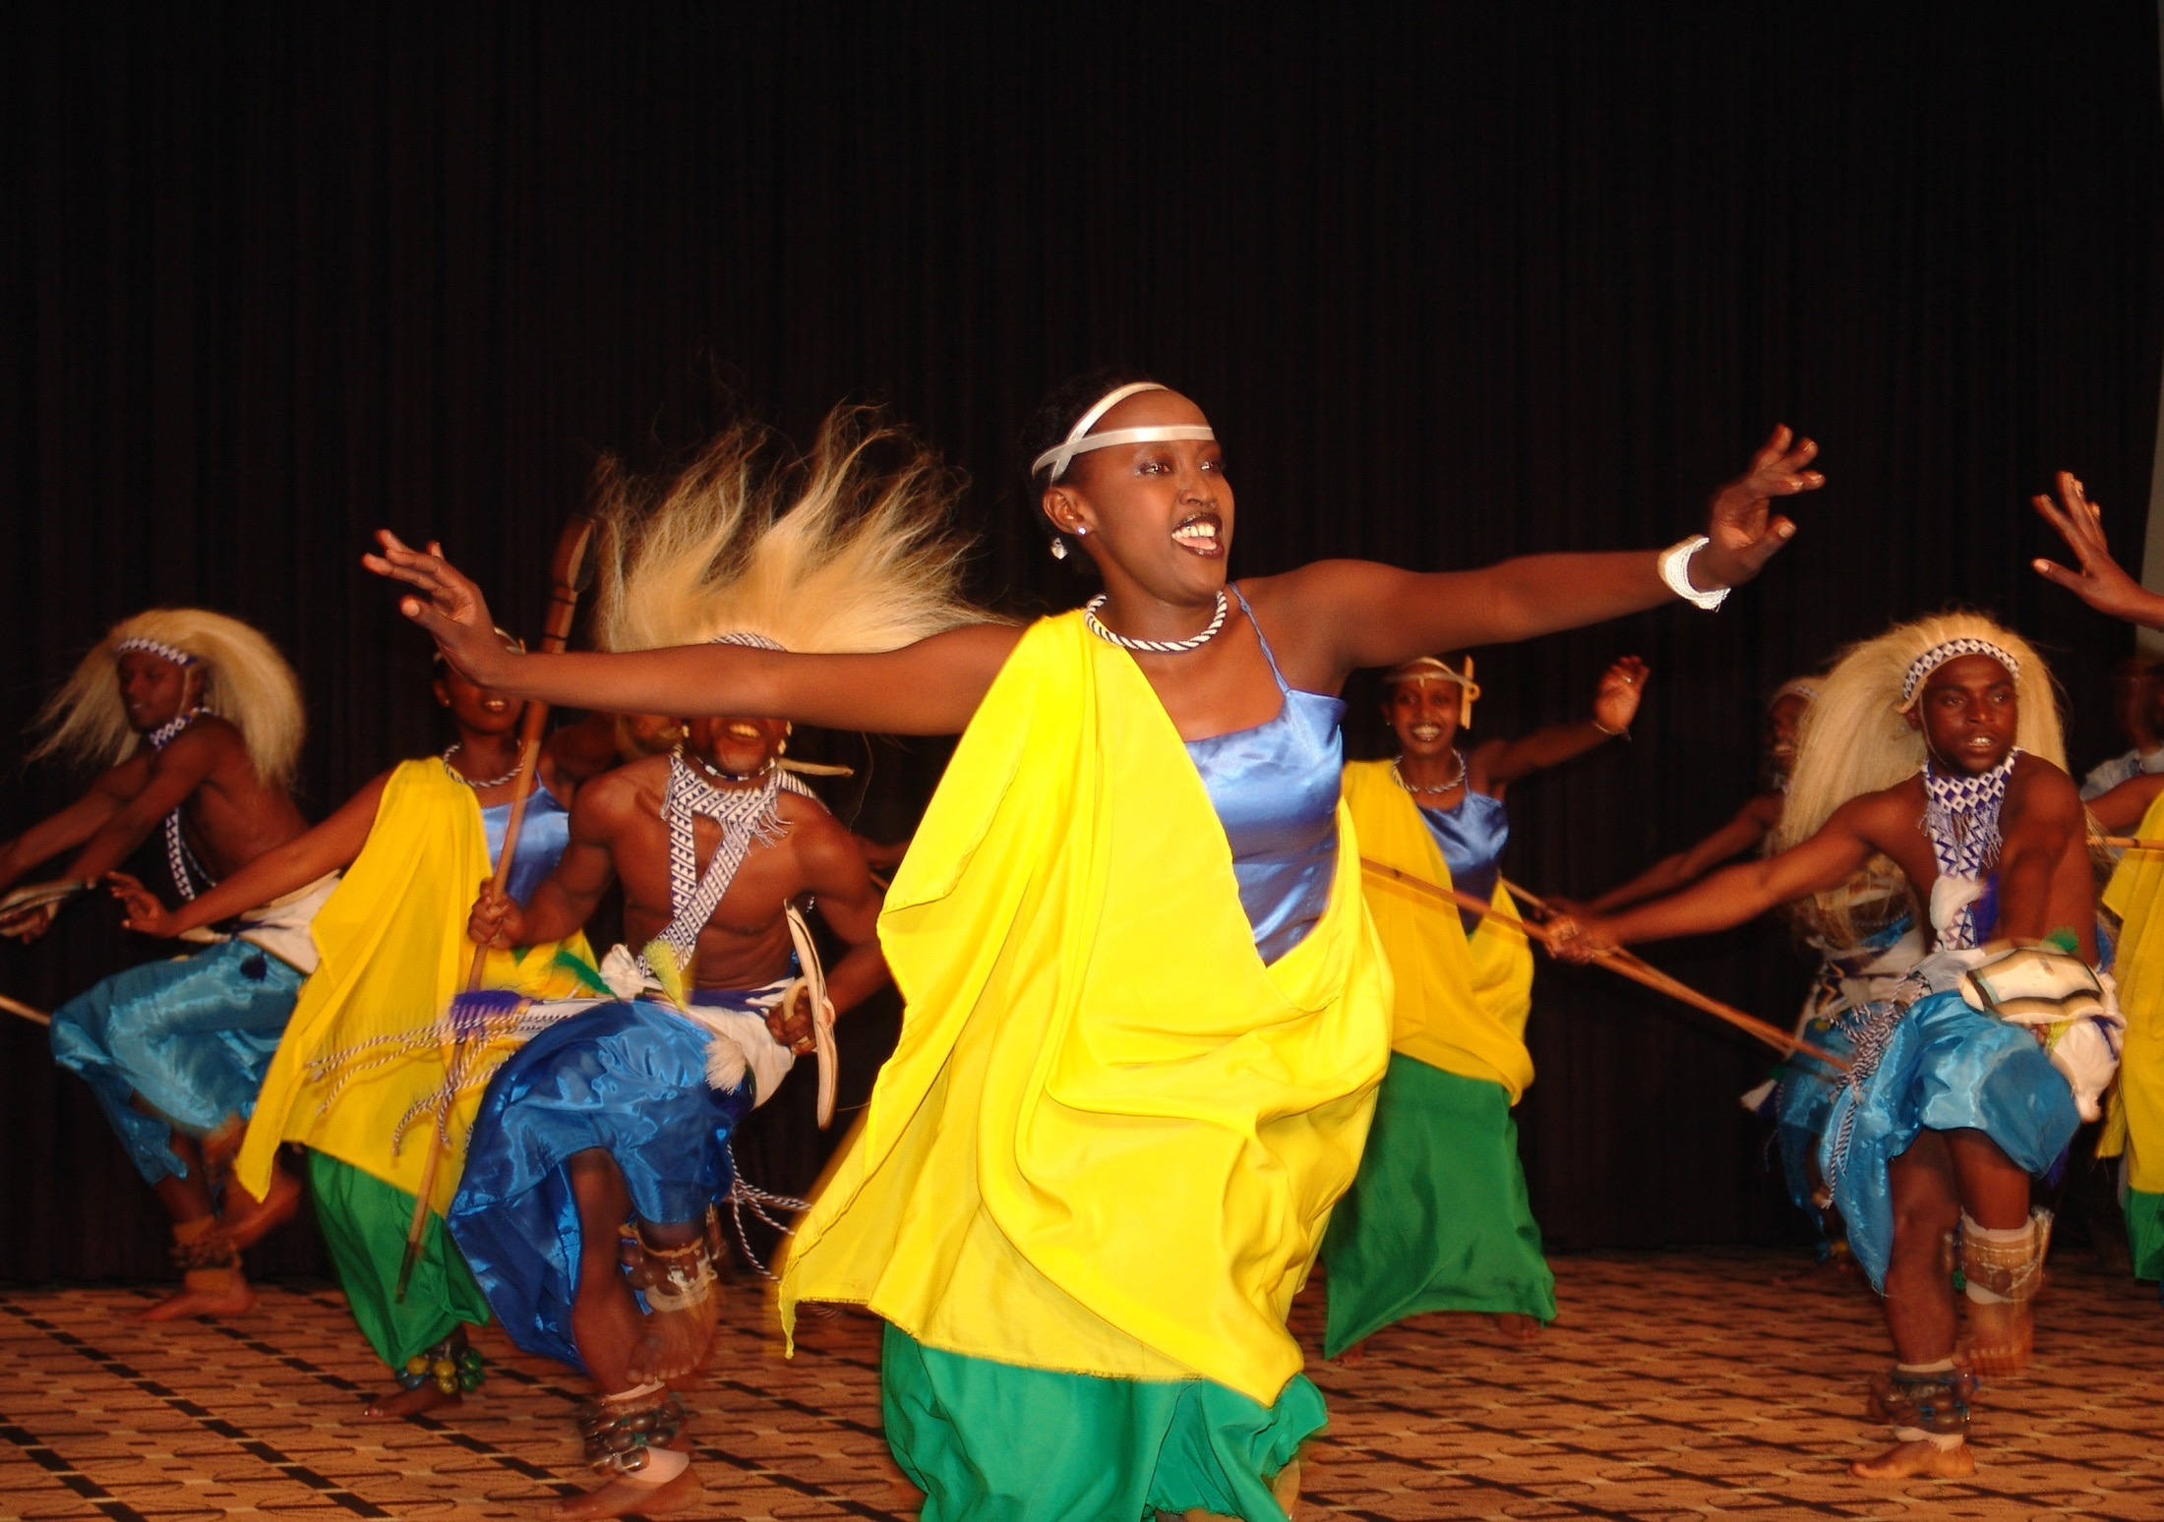
ダンス: Guhamiriza (アフリカで有名)

Slide 10
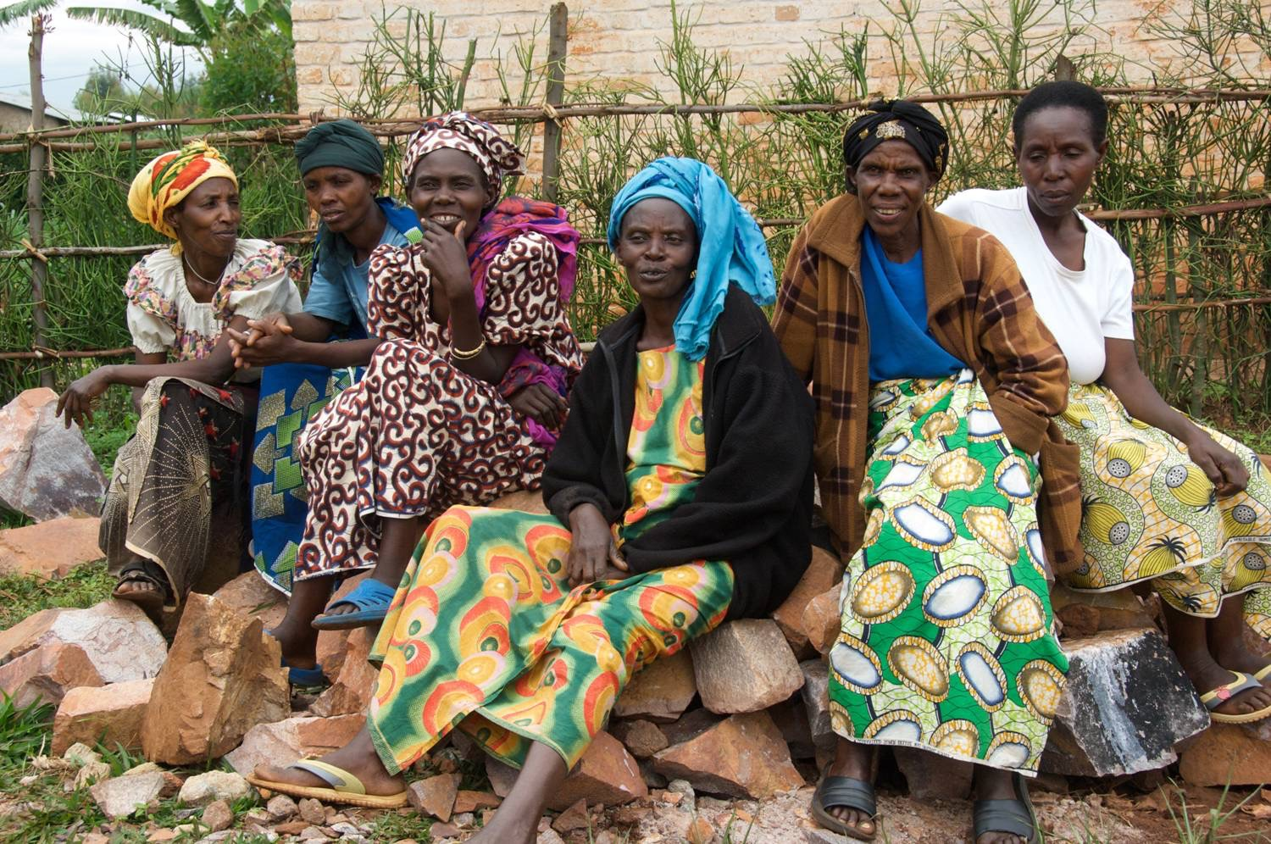
Main Clothes

Slide 11
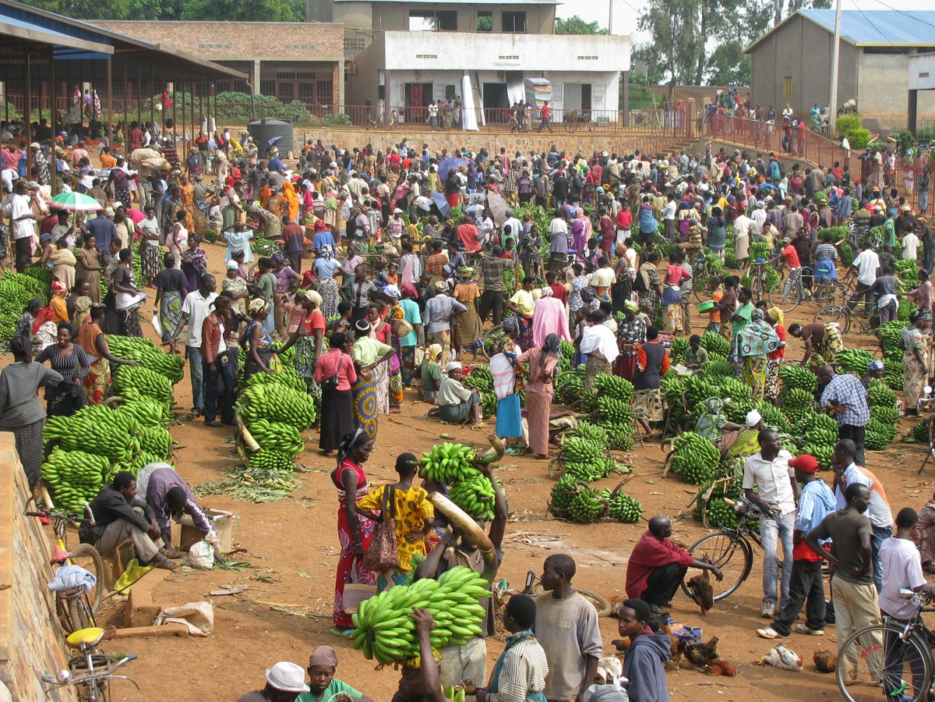
Rwandan Banana Market

Slide 12
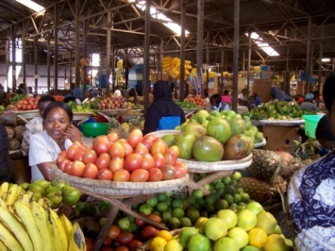
食べ物: イモ、豆、トウモロコシ、米、肉、マトケ（青バナナ） 、キャッサバ、フルーツ

Slide 13
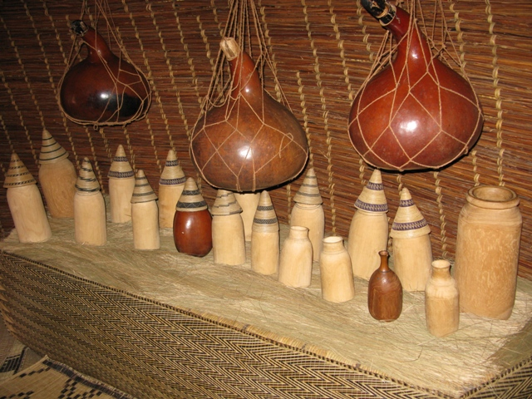
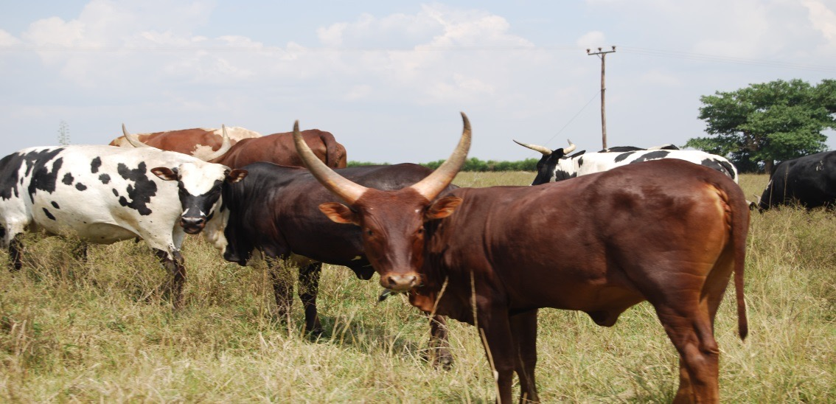
牛乳が名産品

Slide 14
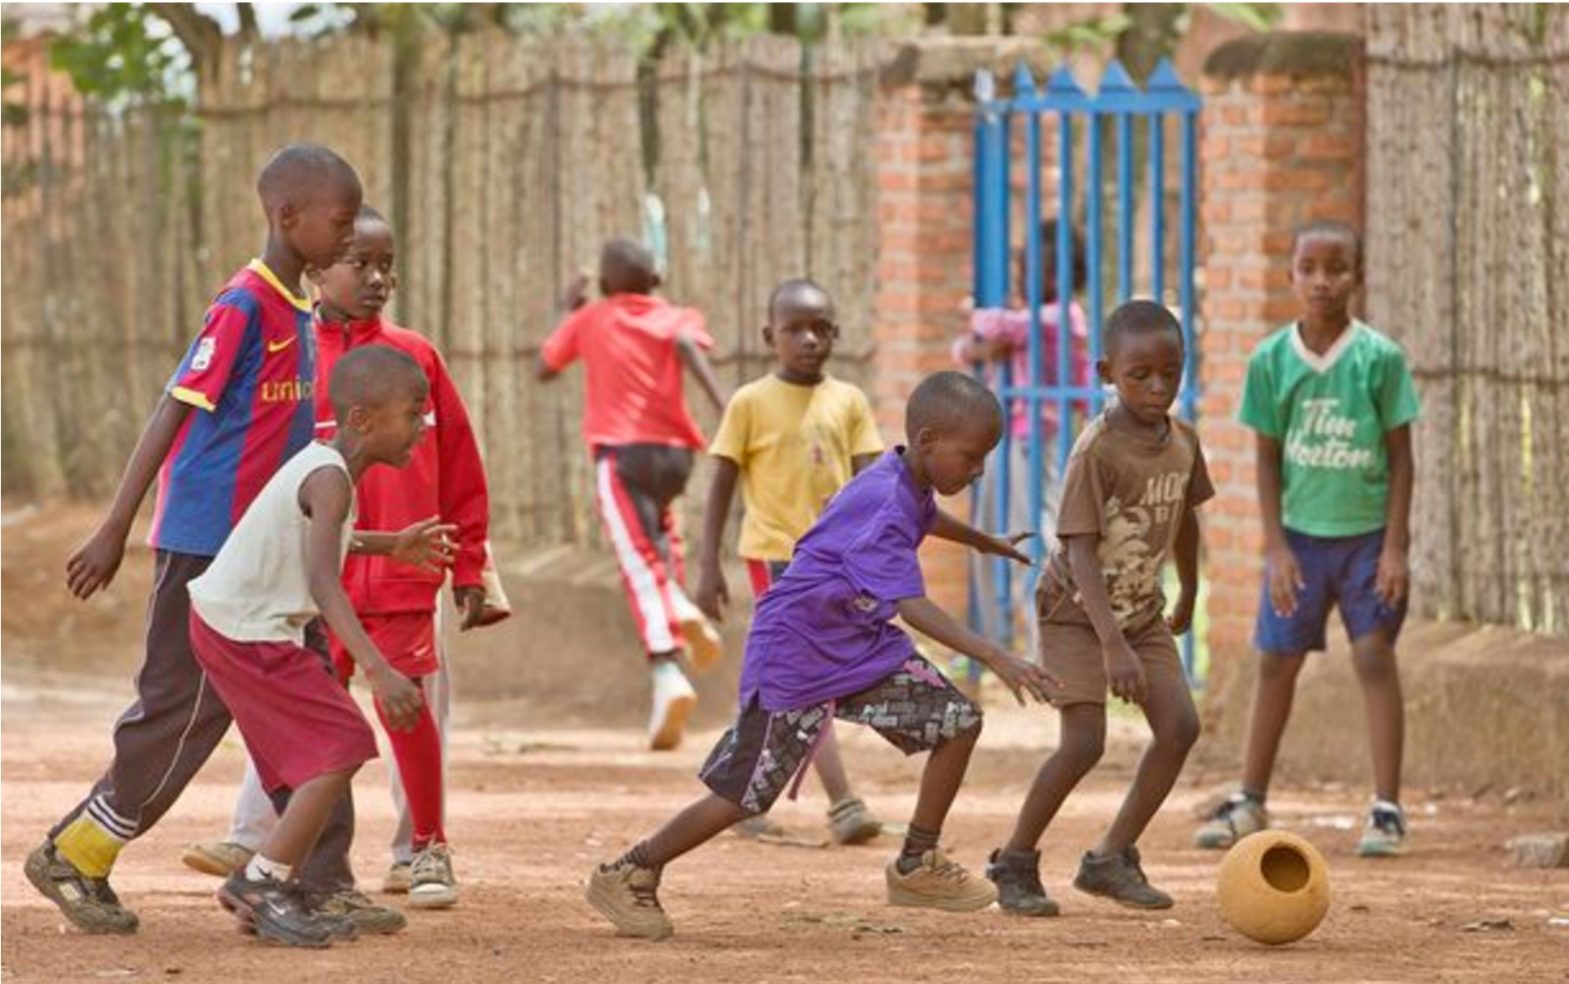
有名なスポーツ

Slide 15
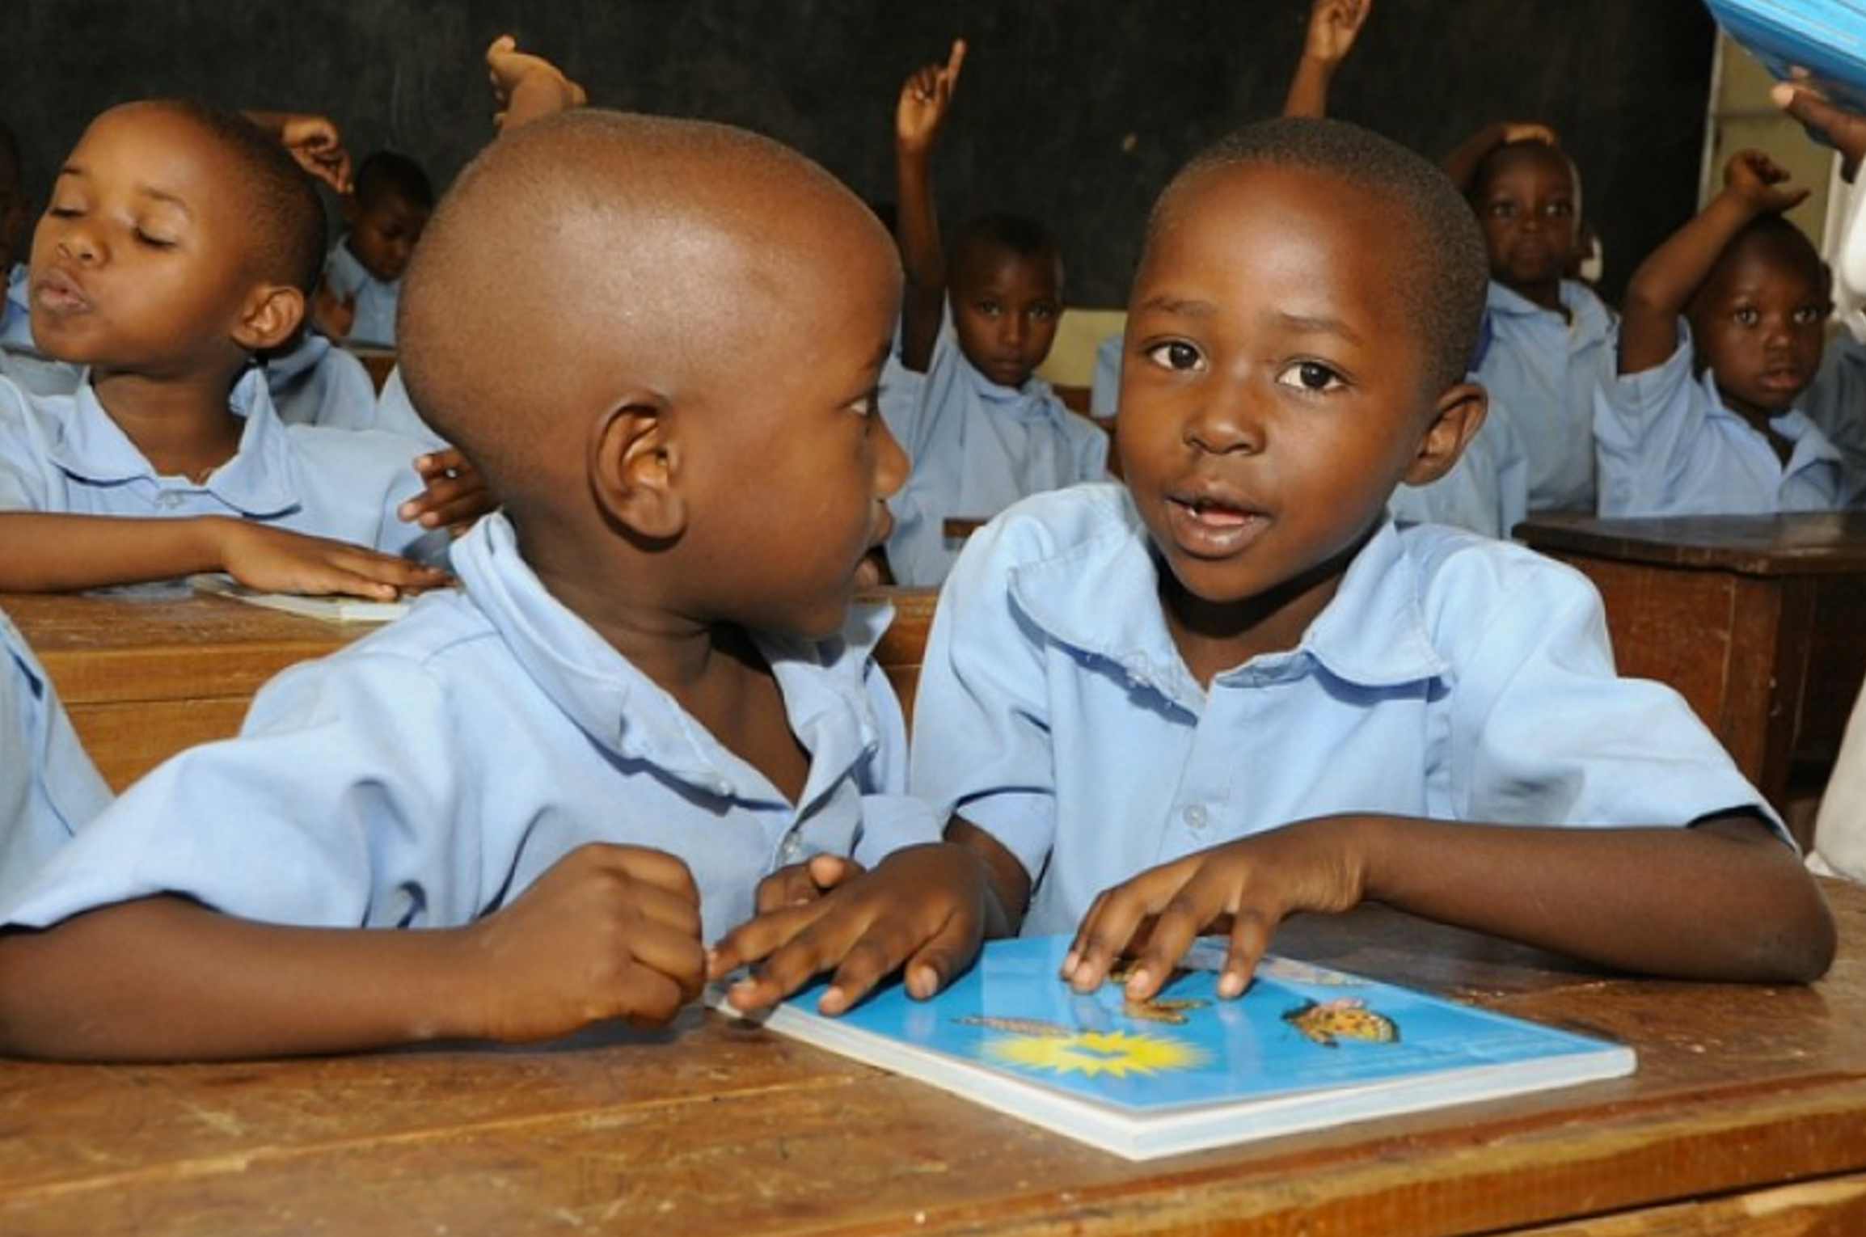
Primary Kids in Rwanda

Slide 16
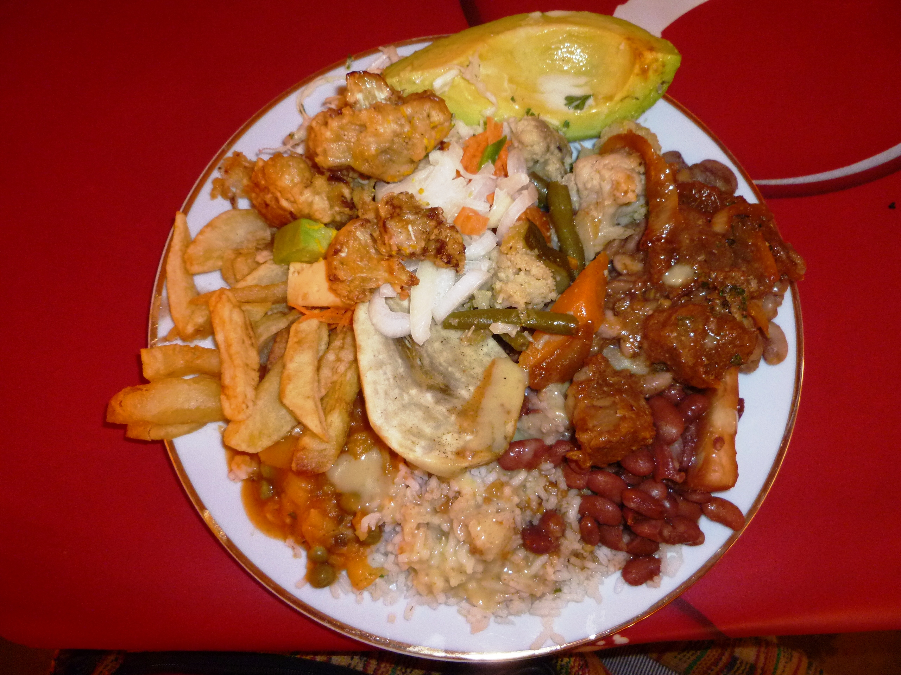
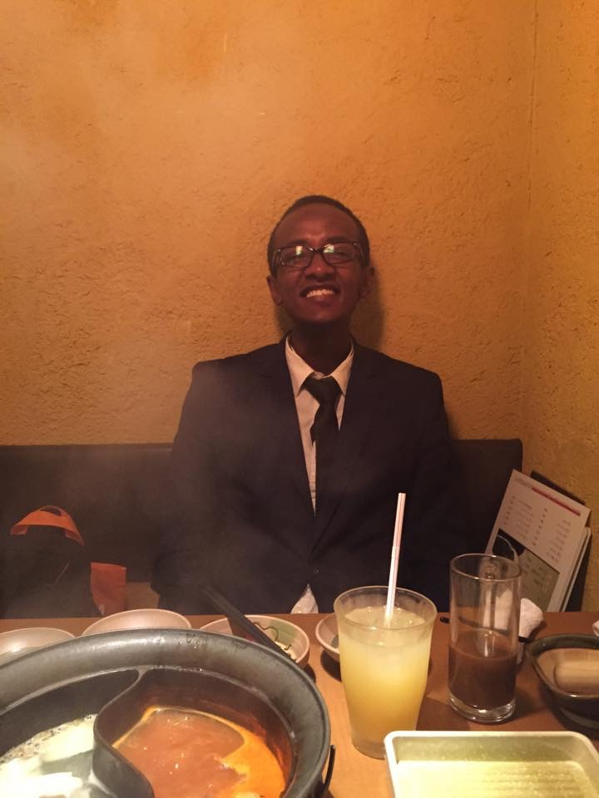
Rwandans like BEANS
My favorite Food
in Japan:SHABUSHABU

Slide 17
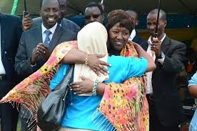
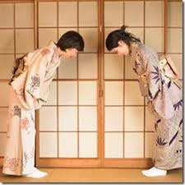
DIFFERENCES -Rwanda&Japan
Bowing
Hugging

Slide 18
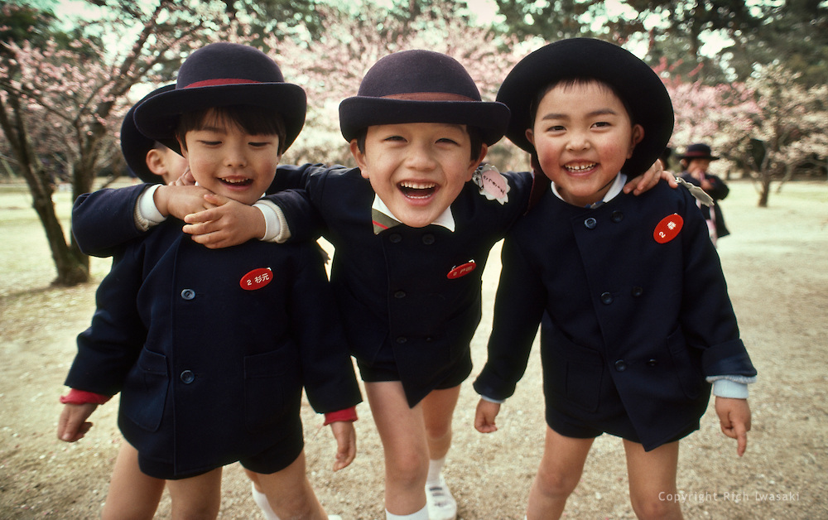
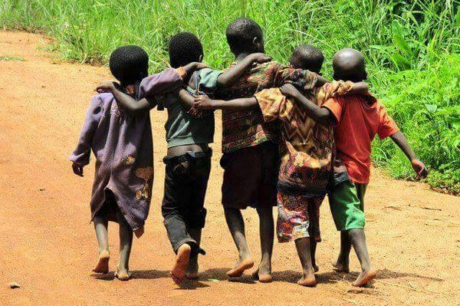
SIMILARITY -Rwanda&Japan
Friendship is very important & Collectiveness

Slide 19
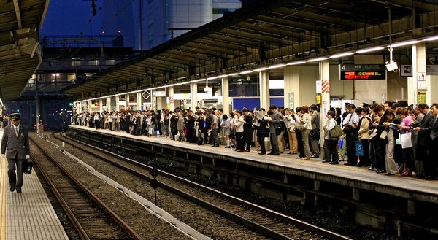
What I think about Japan
1.One word:はやい
2.Busy schedule (Hardwork)
3.Omotenashi
A . Aziz K. MWISENEZA
MPA, Seoul National University
October, 3rd 2014

Slide 20
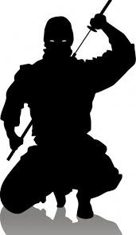
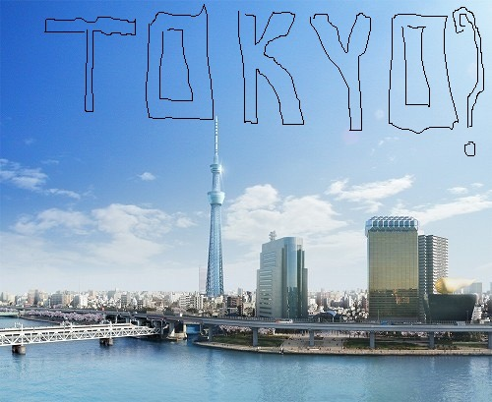
What Rwandans think about Japan?

Slide 21
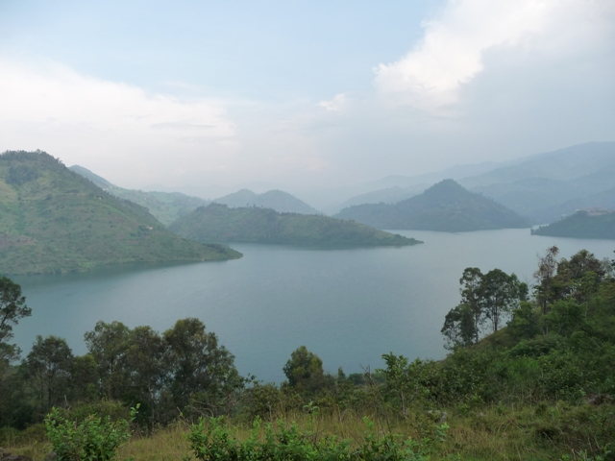
MURAKOZE
THANK YOU
どうもありがとうございました

